Slide 1
CAR PRICE PREDICTION
Nhân bản – Phụng sự – Khai phóng
Machine Learning
Ton That Ron – 21IT042
Le Minh The – 21IT048

Slide 2

CONTENTs
Dataset Overview
Data Cleaning
Missing Data
Data Duplication
Data Analysis
Training Models
Linear Regression
KNeighbors Regressor
Random Forest
Decision Tree
Conclusion

Slide 3
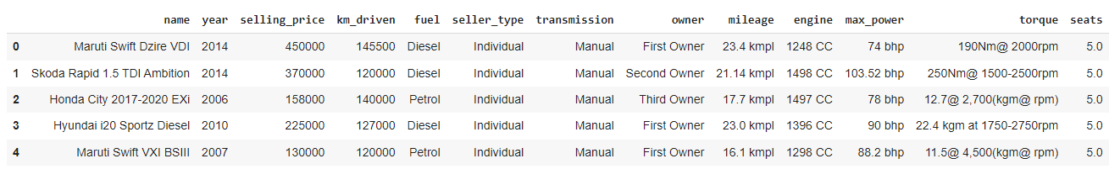
…Dataset Overview
Dataset includes 8128 observations on 13 variables:
name: name of the car
year: year of manufacture
selling_price: resale price
km_driven: number of kilometers traveled
fuel: type of fuel used: Diesel, Petrol, LPG or CNG
sell_type: seller type: Individual, Dealer or Trustmark Dealer
transmission: transmission type of the car: Manual or Automatic
owner: The number of owners who have owned the car: First Owner, Second Owner, Third Owner, Fourth & Above Owner or Test Drive Car
mileage: Number of kilometers traveled per 1 liter or 1 kg of fuel
engine: engine of the car
max_power: Maximum capacity of the car
torque: torque of the car
seats: number of seats in the car

Slide 4
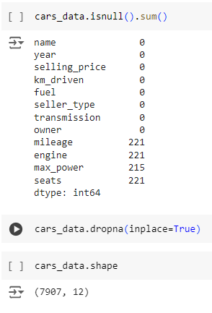
…Data Cleaning
Missing Data
With the original data set with 8128 rows and 13 columns, after deleting the “torque” column and handling missing data, the remaining data is 7907 rows and 12 columns.

Slide 5
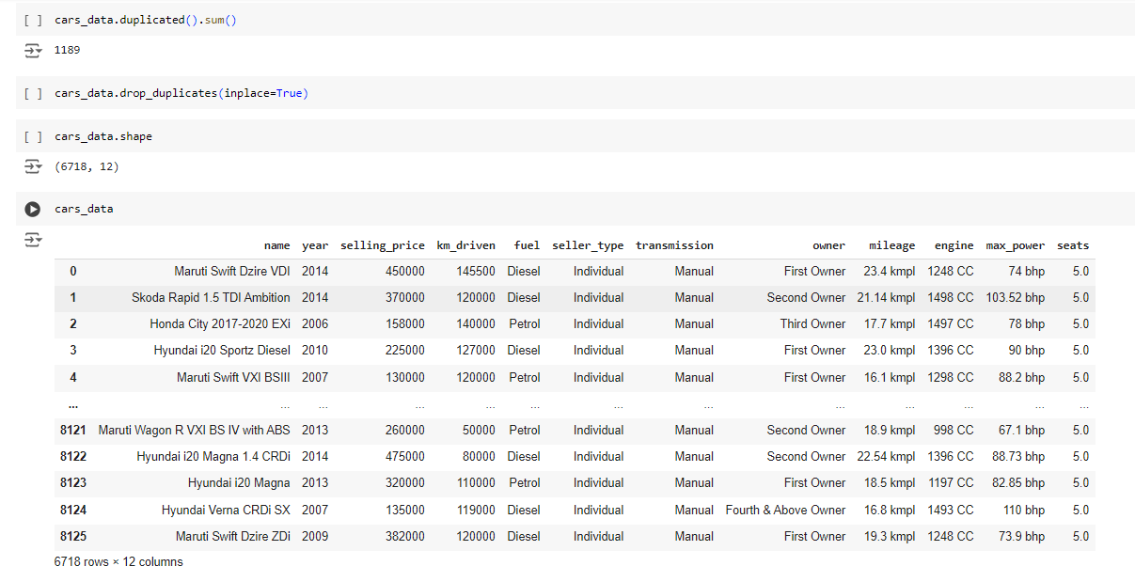
…Data Cleaning
Data Duplication
After handling data duplication, the remaining data is 6718 rows and 12 columns.

Slide 6
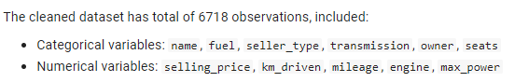
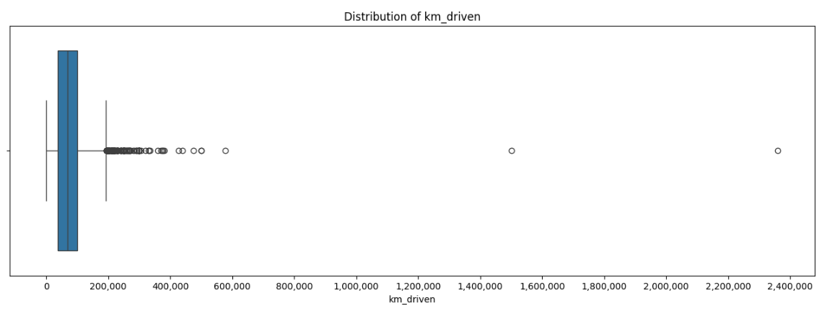
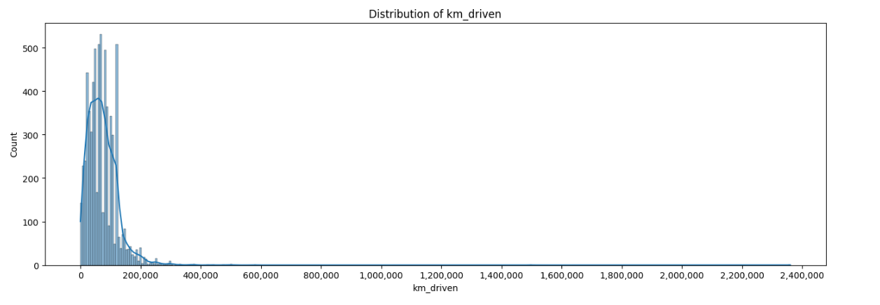
…Data Analysis

Slide 7
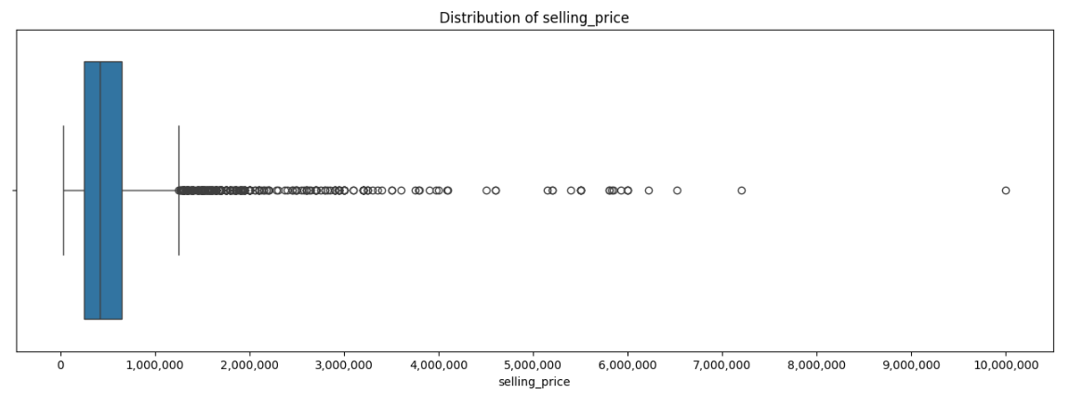
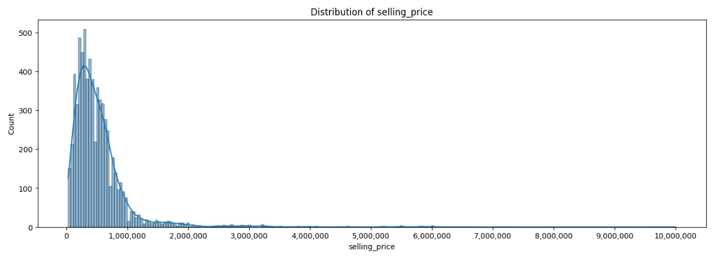
…Data Analysis

Slide 8
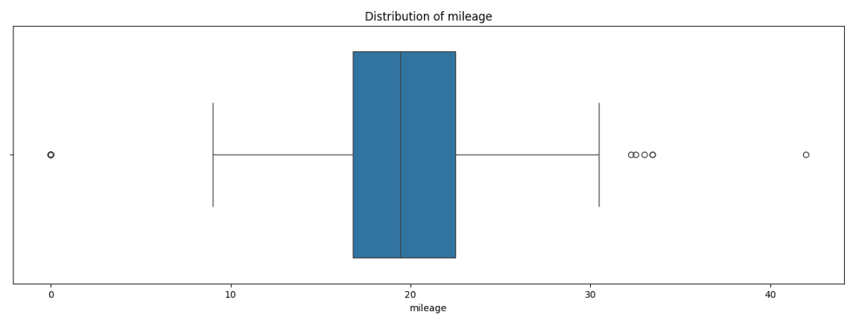
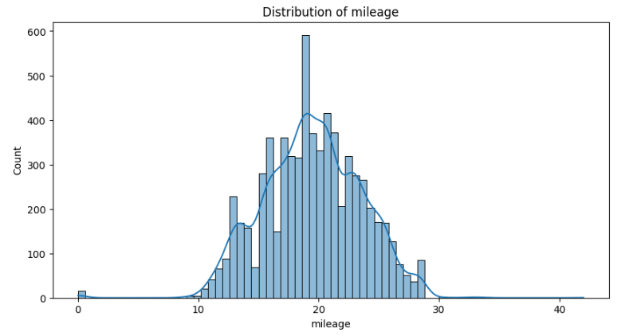
…Data Analysis

Slide 9
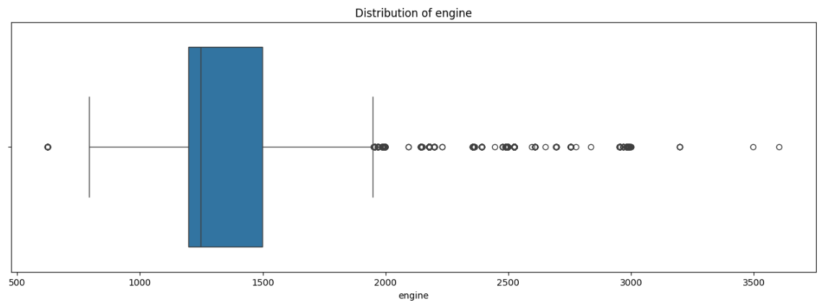
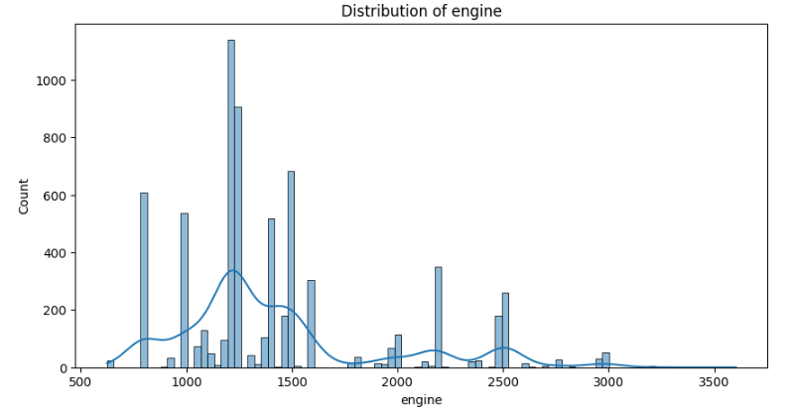
…Data Analysis

Slide 10
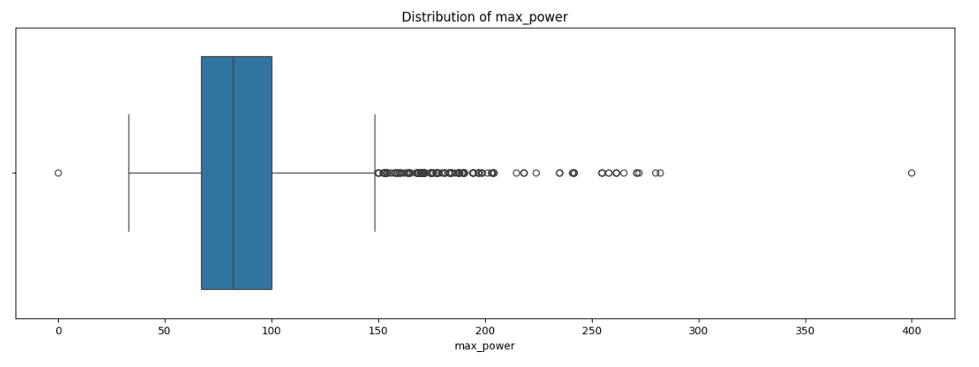
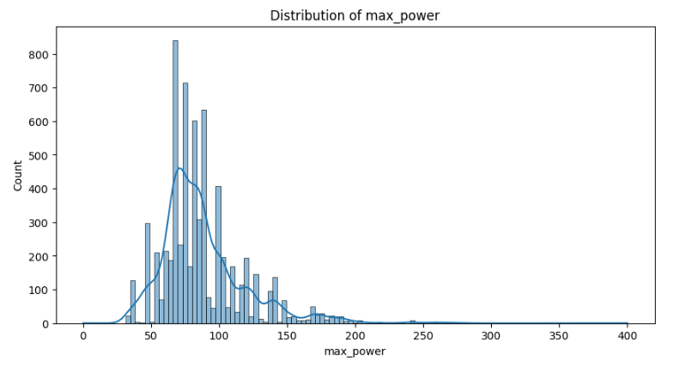
…Data Analysis

Slide 11
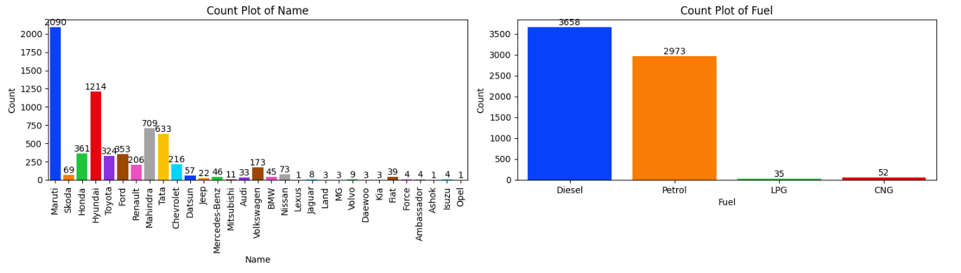
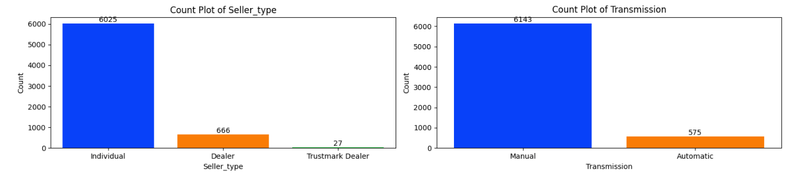
…Data Analysis

Slide 12
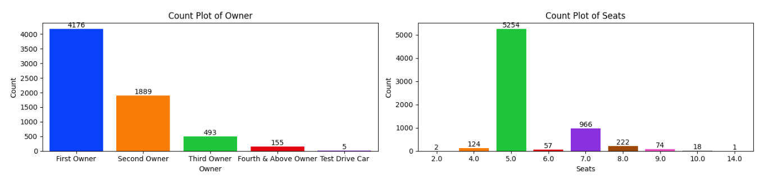
…Data Analysis

Slide 13
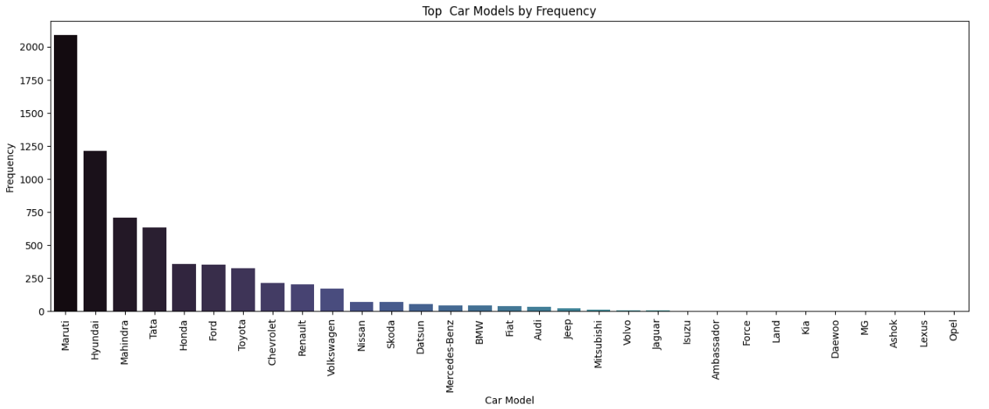
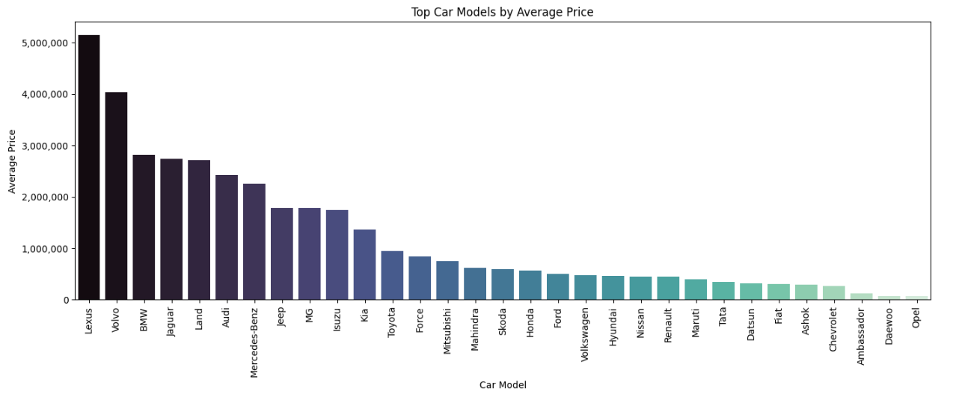
…Data Analysis

Slide 14
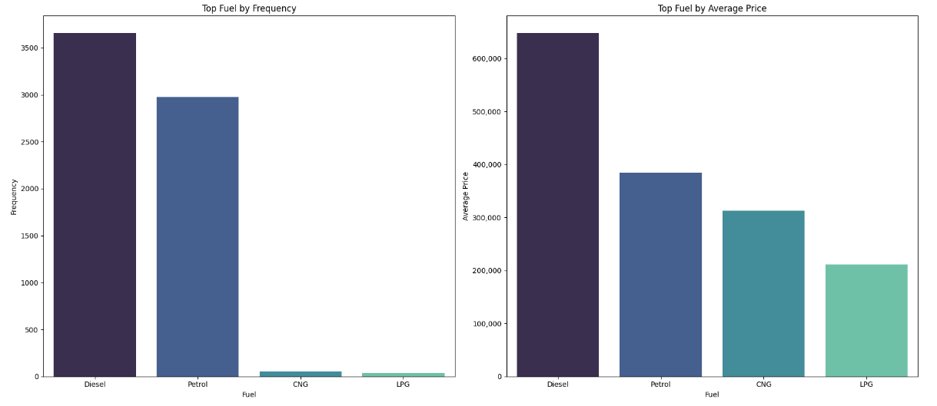
…Data Analysis

Slide 15
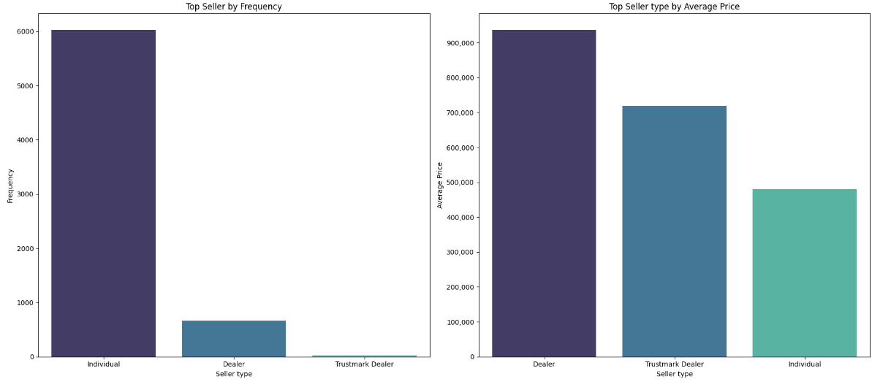
…Data Analysis

Slide 16
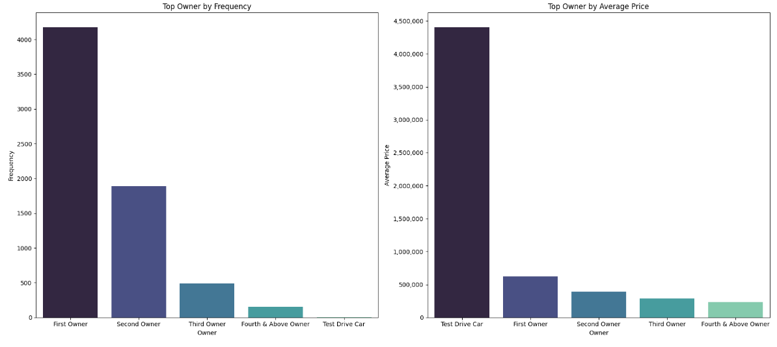
…Data Analysis

Slide 17
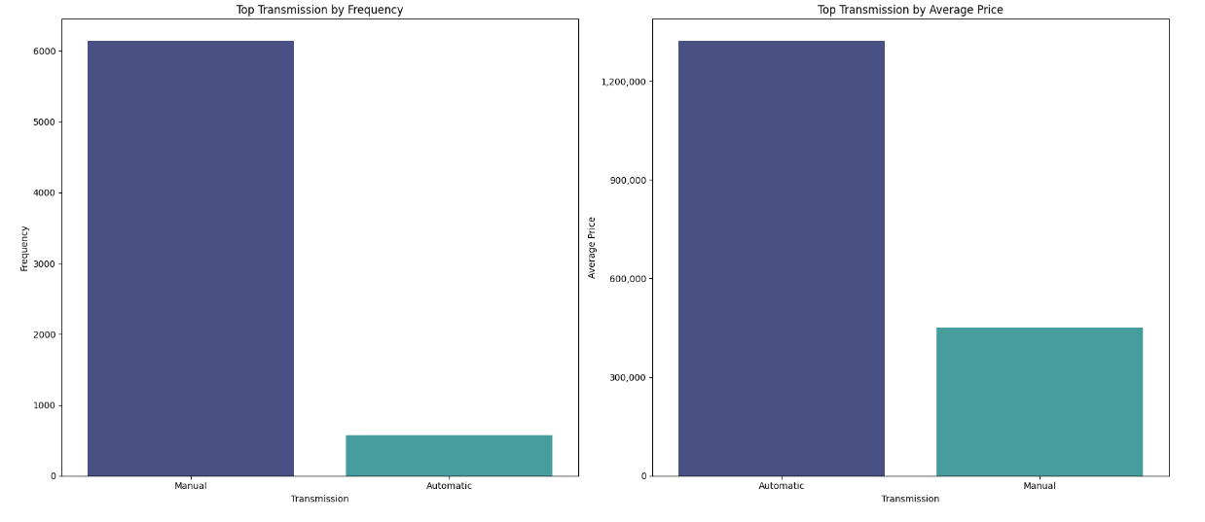
…Data Analysis

Slide 18
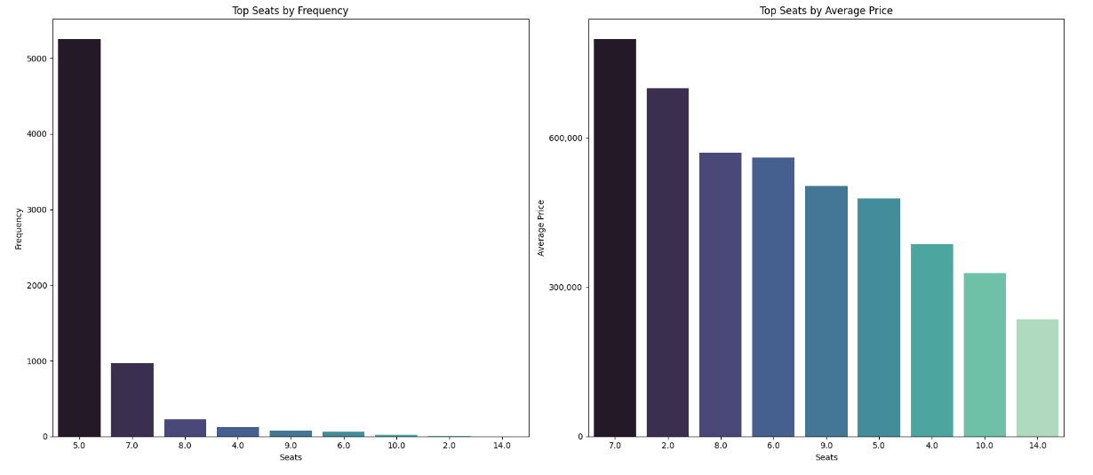
…Data Analysis

Slide 19
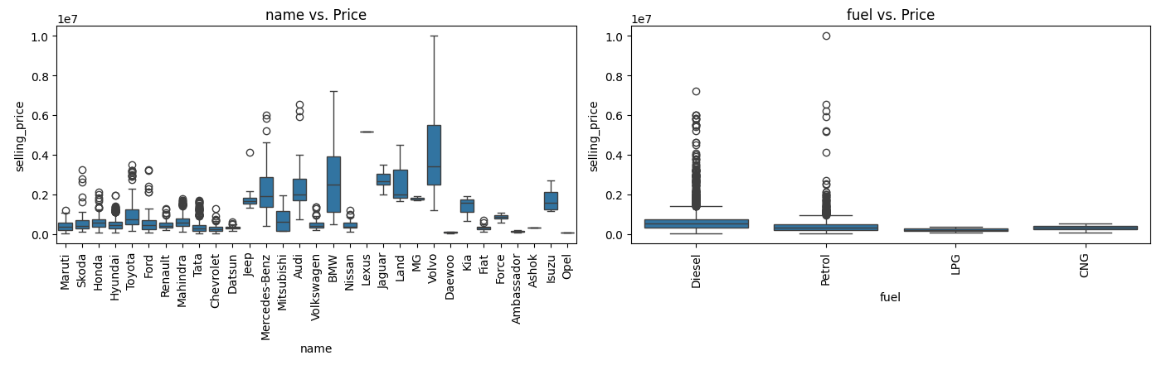
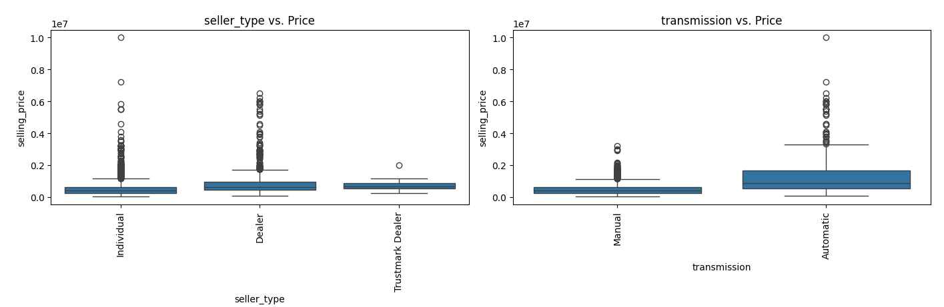
…Data Analysis

Slide 20
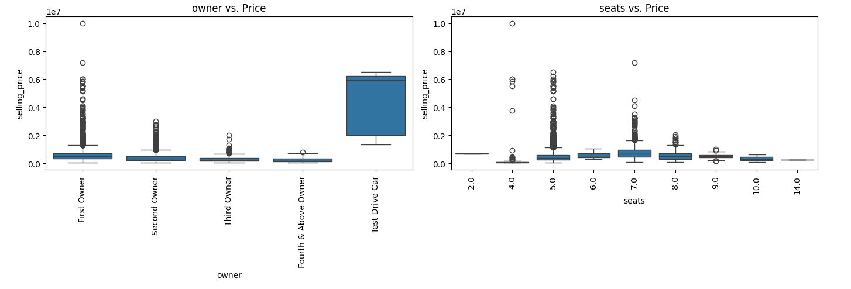
…Data Analysis

Slide 21
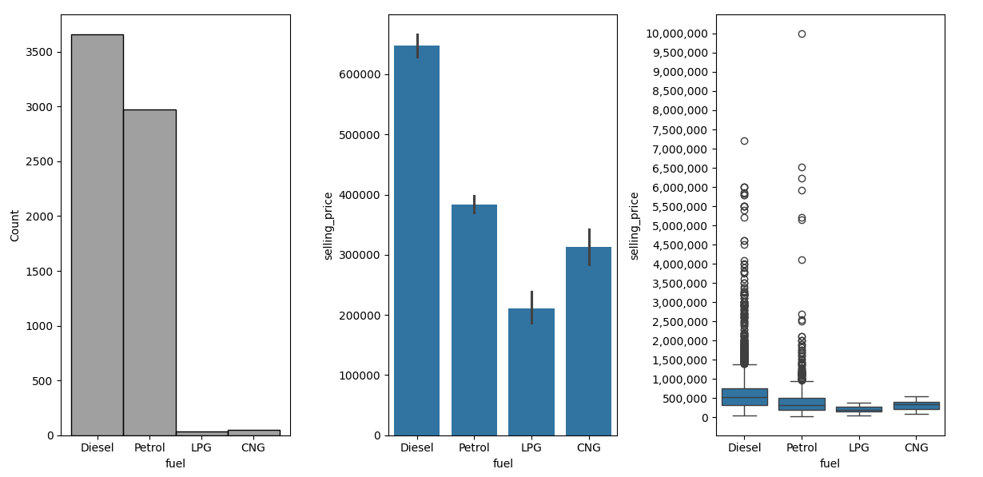
…Data Analysis

Slide 22
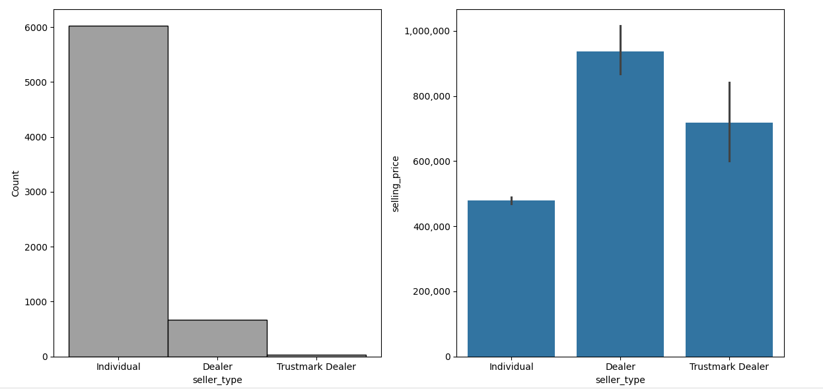
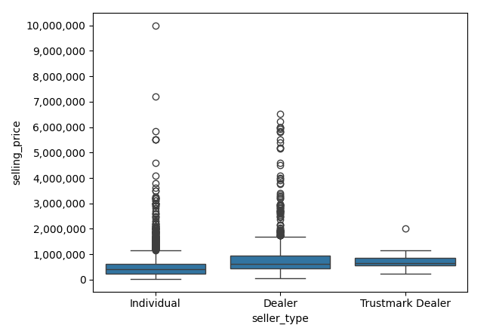
…Data Analysis

Slide 23
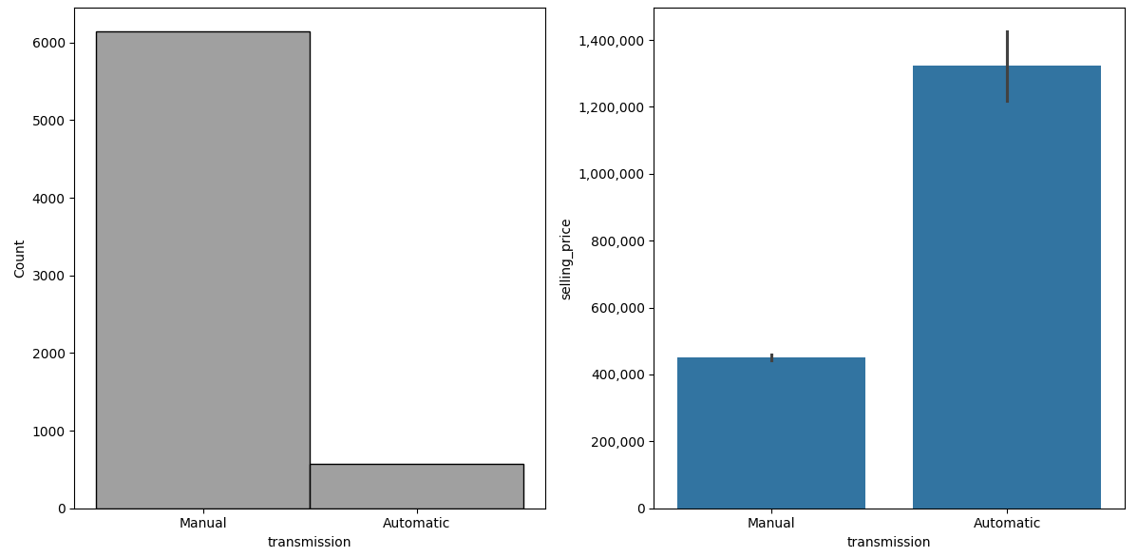
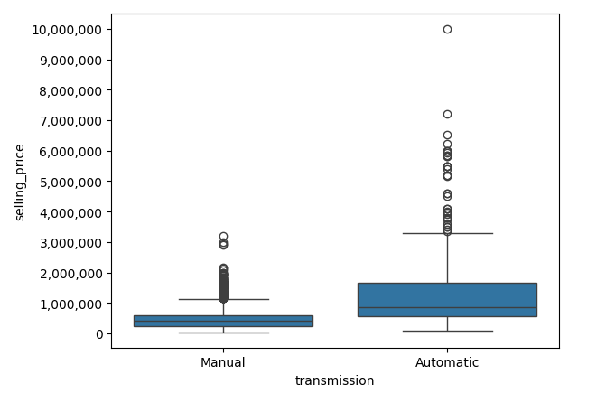
…Data Analysis

Slide 24
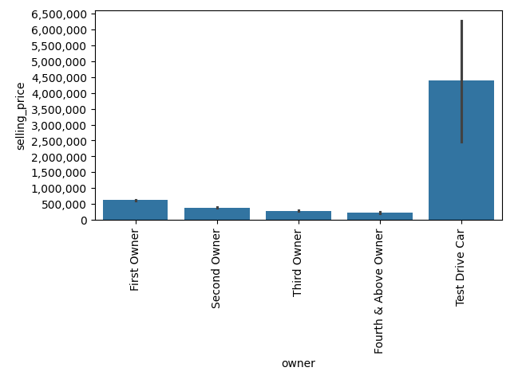
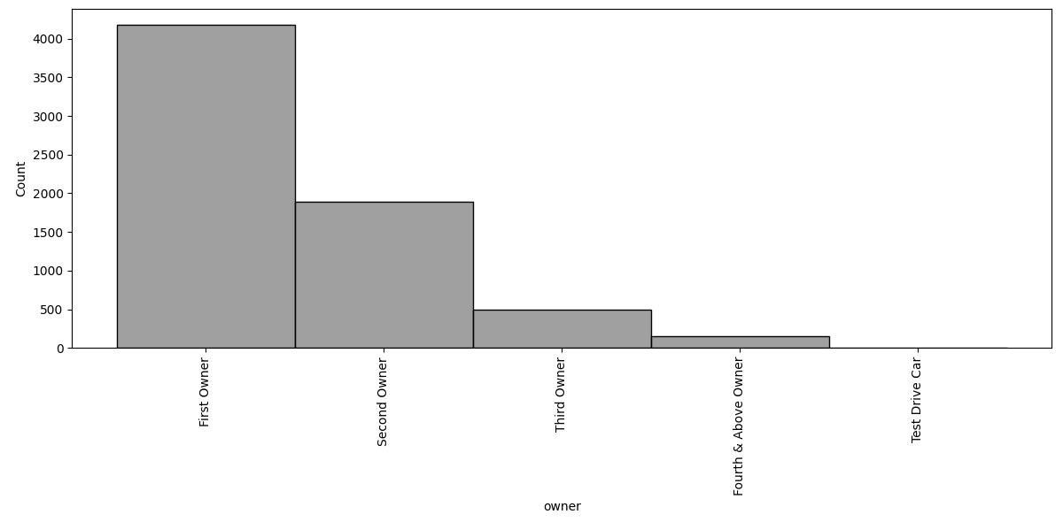
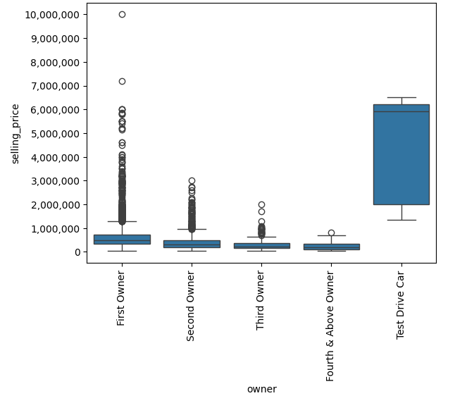
…Data Analysis

Slide 25
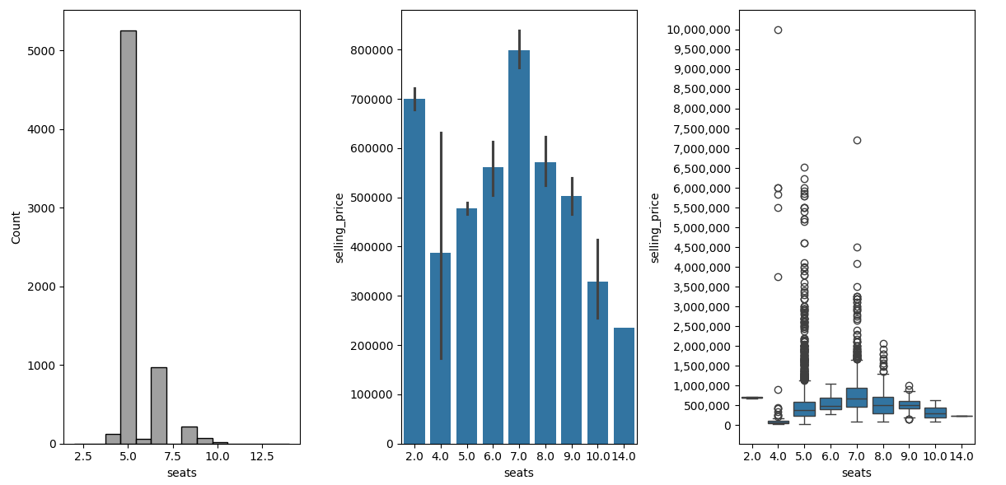
…Data Analysis

Slide 26
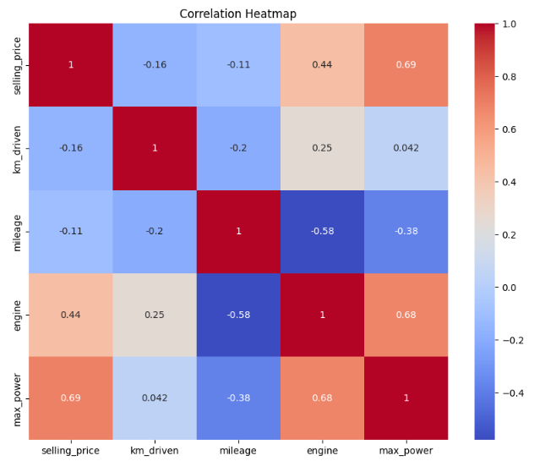
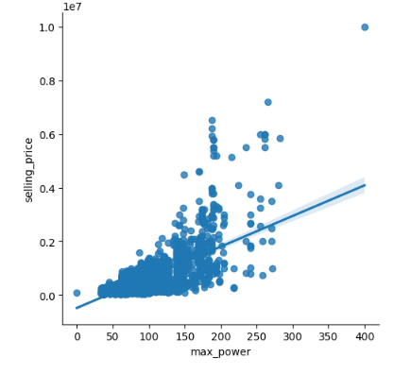
…Data Analysis
max_power has the biggest influence on selling_price.

Slide 27
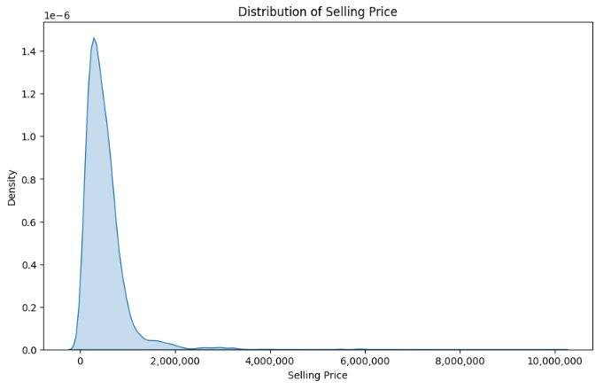
…Data Analysis

Slide 28
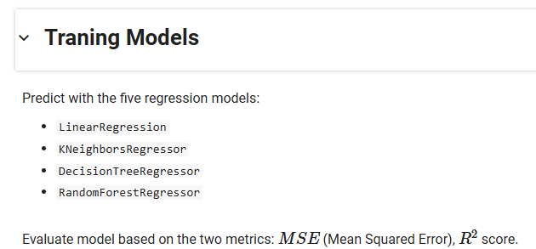
…Training Models

Slide 29
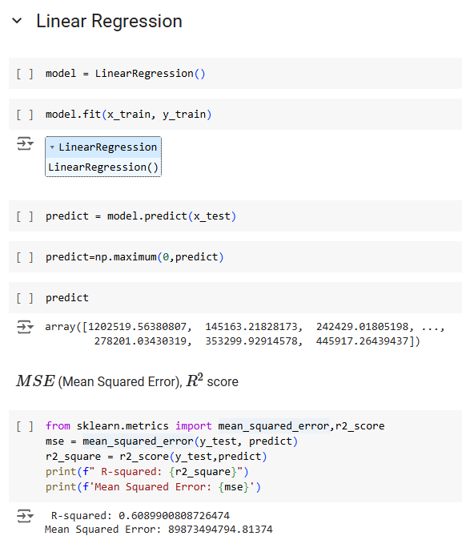
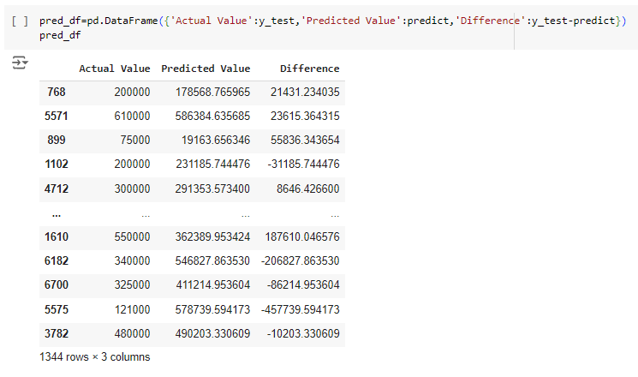
…Training Models

Slide 30
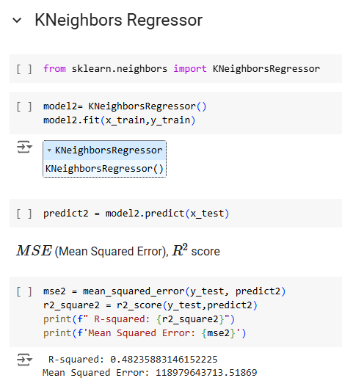
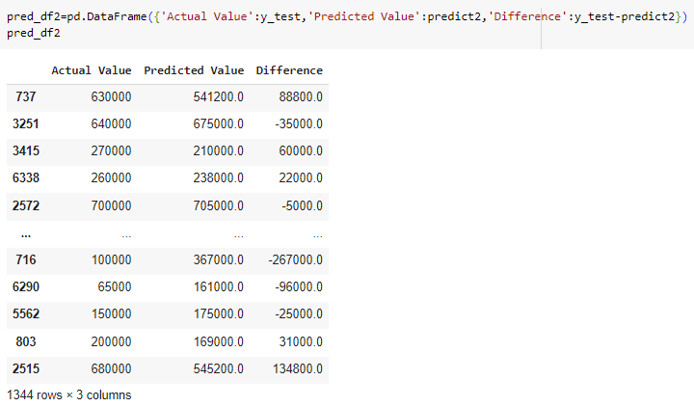
…Training Models

Slide 31
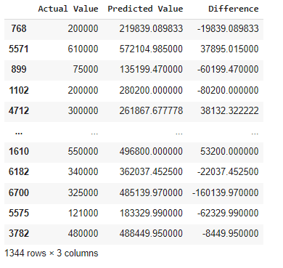
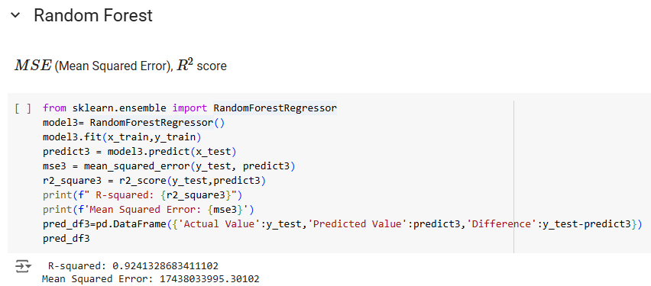
…Training Models

Slide 32
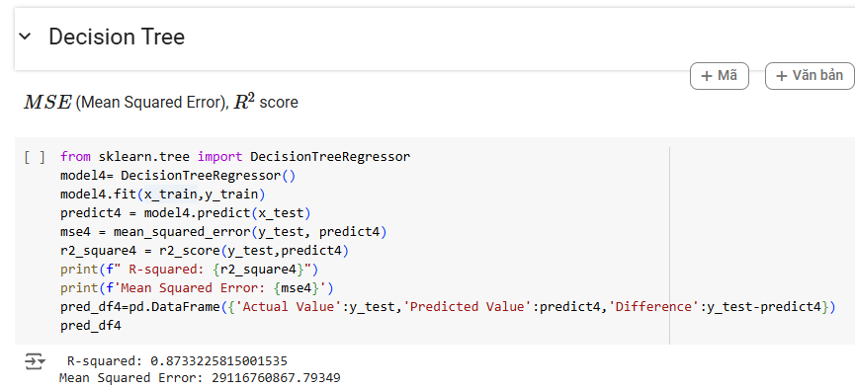
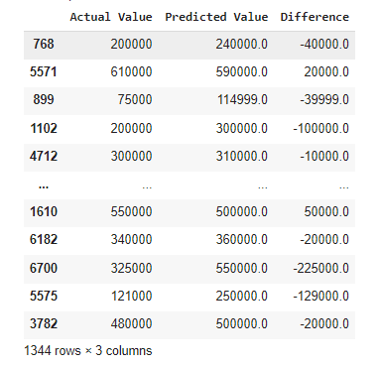
…Training Models

Slide 33
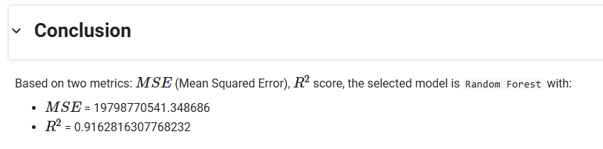
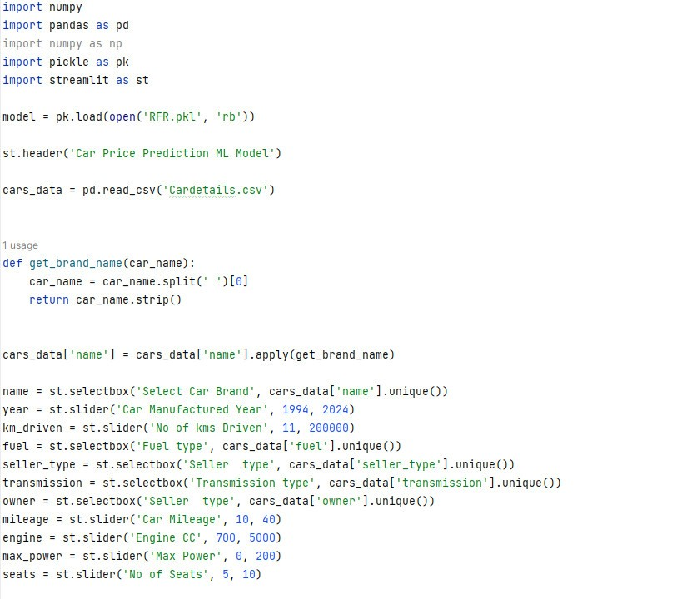

…Conclusion

Slide 34


DEMO
Result:

Slide 35

Thank for listening…!
Nhân bản – Phụng sự – Khai phóng

